Slide 1
Industry Overview - Technology Industry
Fall 2022

Slide 2
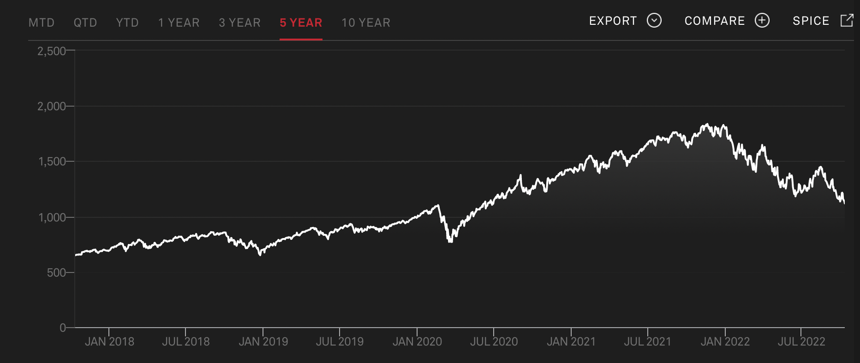
Executive Summary
Industry Definition: The technology sector is the category of companies relating to the research and development, as well as the distribution of goods and services that are technologically powered. The sector contains businesses that manufacture electronics, build software and hardware, and companies that offer services related to information technology.
Our Segments:
Software and Services
Technology Hardware and Equipment
Semiconductors and Semiconductor Equipment
S&P 500 Technology Services industry
‹#›

Slide 3
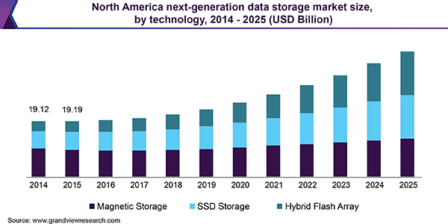
Software and Services
Subsector Definition: The software and services subsector is made up of companies that provide internet services, software, and IT services. These companies can provide products and services such as search engines, as well as social networks and data processing. These software companies can be targeted towards businesses or consumers.
Industry Drivers:
Online Advertising: The revenue for internet and software services is highly correlated to overall advertising spend as this is the main revenue generator for many of these companies. The performance of businesses like Facebook and Snapchat are heavily dependent upon advertising, and thus, are cyclical businesses as advertising is one of the first costs a business will cut in the case of an economic downturn or when it faces stress.
Rise in Enterprise Data: Every year more data is created and collected, necessitating further storage for all of this data, which drives demand for data storage businesses.
Companies:
Microsoft
Adobe
ServiceNow
Equinix
‹#›

Slide 4
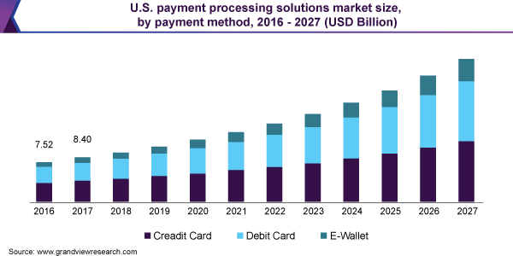
Technology Hardware and Equipment
Subsector Definition: The technology hardware and equipment subsector can be broken down into communications equipment, which consists of: routers and telephones, hardware storage, which consists of companies that produce cell phones, PCs, and servers, and finally, electronic equipment, which consists of companies that make barcode scanners, and security equipment, among other products.
Industry Drivers:
Overall Health of the Economy: Many PC companies and cell phone companies are reliant on a strong economy to drive sales. When there is an economic downturn and people have less disposable income, they are less likely to spend on expensive cell phones. Additionally, companies such as Dell and Microsoft have deals with large corporations to sell them PCs and other technology hardware for business, but in an economic downturn these companies will be less likely to spend on upgrading these systems and computers.
Increase in Payment Volumes: Benefits Point-of-Sale technology hardware sales to businesses, as well as security systems
Companies:
Apple
Samsung
Dell
‹#›

Slide 5
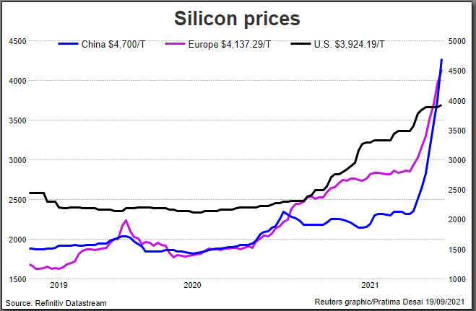
Semiconductors and Semiconductor Equipment
Subsector Definition: The semiconductors and semiconductor equipment subsector consists of companies involved in the manufacturing and distribution of semiconductors, or substances which conduct electricity to control electrical currents.
Industry Drivers:
Prices of Raw Materials: Silicon is a major input for semiconductors, so the price of Silicon can affect profit, but also output for a semiconductor company
Health of Military, Healthcare, and Automobile Industries: Since semiconductors are used in all sorts of electronics, many industries depend on them, such as the auto industry and the military
Companies:
Nvidia
AMD
TSMC
Intel
Qualcomm
‹#›

Slide 6
SWOT Analysis
Strengths & Opportunities
Weaknesses & Threats
Software and data storage companies are less cyclical than companies in many other industries, as many of these companies solve issues that are ongoing and unaffected by economic cycles, such as data storage
5G rollout offers opportunities for many technology companies in the cellular space and phone industry, such as Apple and Samsung
The CHIPs Act of 2022 aimed at increasing semiconductor manufacturing within the U.S.
There is a lack of a strong “moat” in many software businesses, and while incumbent companies dominate the market, many companies are ripe for disruption by new players
Many of the software companies, such as Google and Facebook which rely heavily on advertising have cyclical businesses and see their revenues and margins drop the most in an economic downturn, and with the possibility of a recession in the near future, these companies pose many potential risks
‹#›

Slide 7
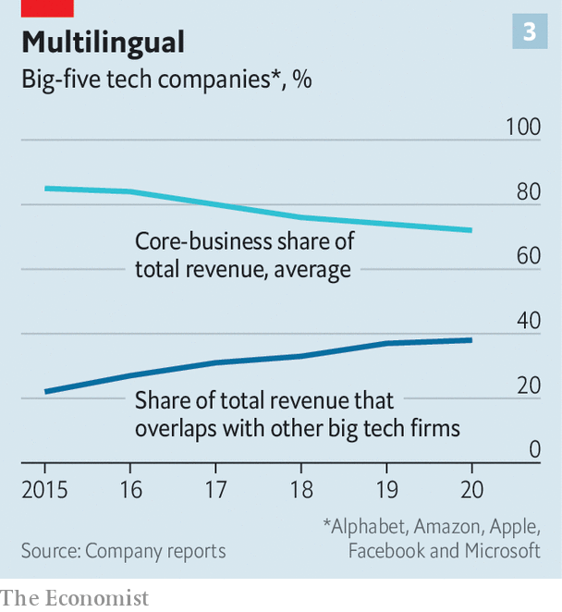
Competitive Landscape
The technology industry in the United States is growing at a rapid rate, with intense competition. Since innovation is an important key to success in this industry, large portions are spent on Research & Development.
There has been a shift towards services since the onset of the pandemic – software-as-a-service and hardware-as-a-service have grown in demand as a way for businesses to gain recurring revenue.
Supply-chain disruptions over the past few years have shown the need for technology in transforming outdated supply chains. Semiconductors and robotic automation of manufacturing processes have been a big trend in the past few years
Antitrust laws govern many markets, but since R&D spending is such a large factor for technology companies, it is rare for an incumbent monopolist to become lazy or act in a monopolistic manner
Semiconductor manufacturing is a very competitive industry right now, but there are not many options for smaller players to gain market share as the barriers to entry are significant, including the massive costs to build a semiconductor manufacturing plant
The technology hardware industry is fairly fragmented, with companies like Apple, Microsoft, Intel, HP, Cisco, and Oracle all competing to be the market leader
‹#›

Slide 8
Segments of Interest
Segment of Interest
Rationale
Software and Services
Software sold by companies such as Microsoft (Excel), Adobe, and Google are essential to our economy and everyday lives
Technology Hardware and Equipment
Technology hardware such as PCs and data storage centers are increasingly important as enterprise software sees growth among businesses
Semiconductors and Semiconductor Equipment
Semiconductors are essential to practically every electronic device and product we make and use
‹#›

Slide 9
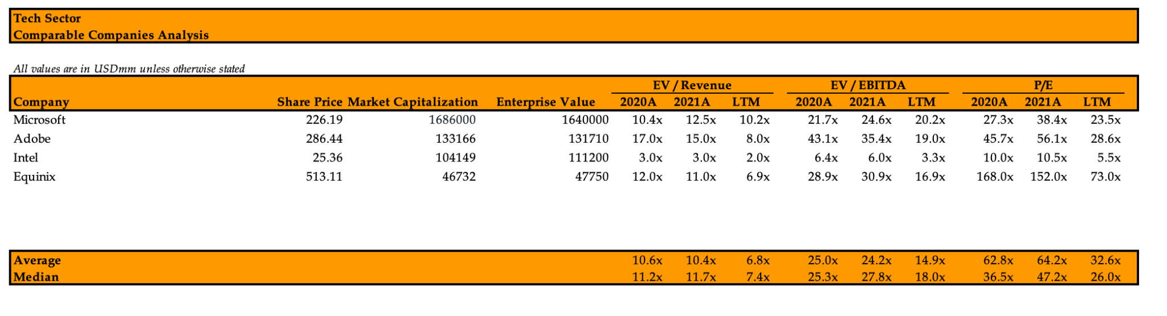
Public Comparables
‹#›

Slide 10
About Brandeis Investment Club
Founded in 1998, the Brandeis Investment Club was established to provide the highest quality undergraduate investing experience for students interested in pursuing careers in finance. We provide our members with the opportunity to learn finance “hands on” through the collaborative management of a real portfolio. Through our coveted New Analyst Training Program, we provide our newest members with the ability to invest using the basic technical valuation methods of fundamental analysis. Over the course of several years, our analysts have the opportunity to invest in real time using a process developed in conjunction with industry experts with a portion allocated to us by the university’s endowment. We also provide career-oriented training which enables our members to be placed in highly competitive entry-level jobs in finance. In collaboration with industry professionals, Brandeis faculty, and our club members, we are continuing to build an incredible organization, fully devoted to its members’ success.
Ethan White
ethanwhite@brandeis.edu
Head Analyst
Max Wice
Analyst
Sohun Sanka
Analyst
Sam Dienstag
Analyst

