Slide 1
Financials Industry Overview
Fall 2022

Slide 2
Executive Summary
Industry Definition:
This sector comprises establishments primarily engaged in financial transactions and/or in facilitating financial transactions.
Three principal types of activities are identified as: raising funds by taking deposits, issuing securities and, in the process, incurring liabilities.
Industry Drivers:
a. Consumer Confidence Index
b. Corporate Profit
c. Per Capita Disposable Income
d. Regulation for the Banking Sector
Investment Opportunities: Asset Management(including PE/VC), Investment Banking, Fin-tech.
Competitive Landscape: The Finance industry is characterized by low levels of market concentration, with the four largest operators (insert) accounting for only 10.7%
of industry revenue. Competition between operators is intense and increasing.
Investment Thesis:
‹#›

Slide 3
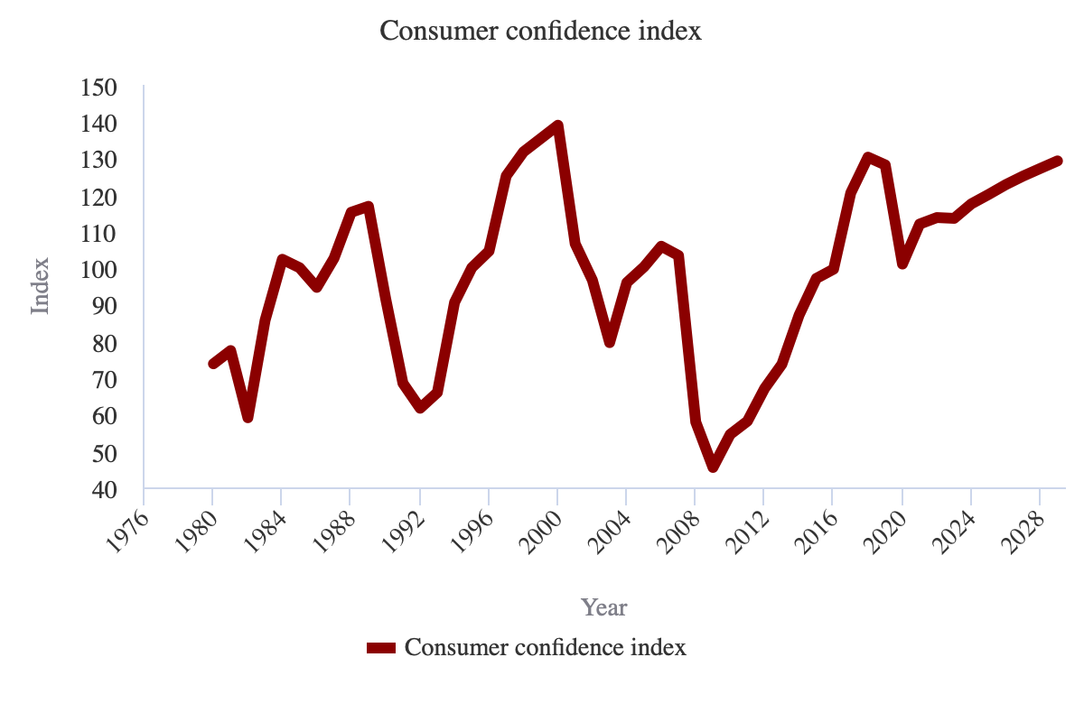
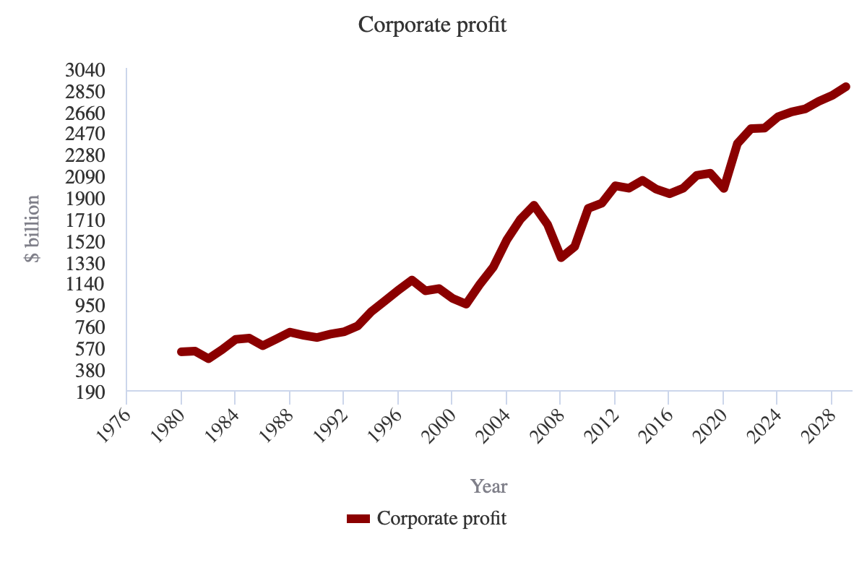
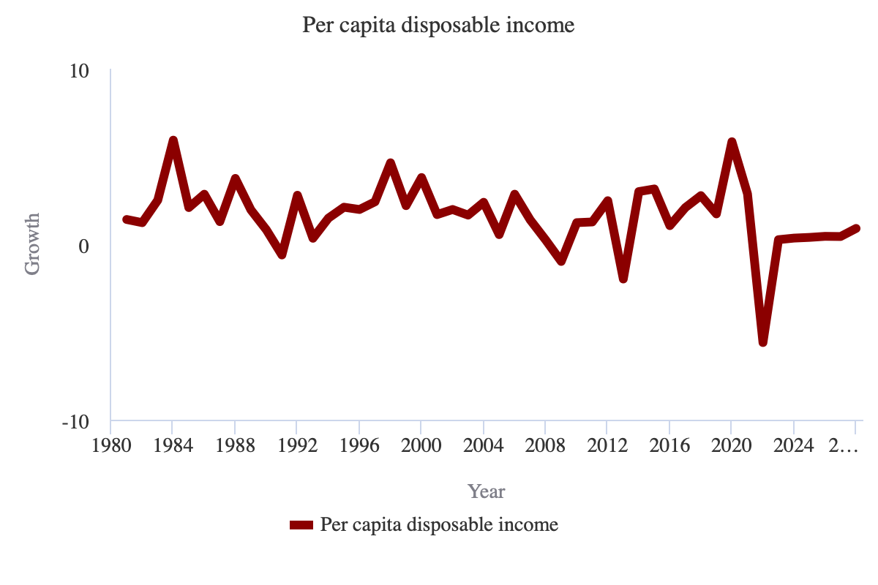
Industry Drivers
Consumer Confidence Index
As consumers' confidence in the economy increases, their overall level of consumption tends to increase. Operators in this sector benefit from increased consumption levels by consumers, as they provide a variety of services that consumers need to make transactions. In 2022, the Consumer Confidence Index is expected to increase, presenting a potential opportunity for the sector.
Corporate Profit
Increasing corporate profit levels also benefits operators in this sector. As business operations become more profitable, operators are more likely to undertake new projects to expand their businesses that require the services of operators in this sector. This materializes in the form of increased demand for operators' services. In 2022, corporate profit is expected to increase.
Per Capita Disposable Income
As per capita disposable income levels rise, consumer long-term financial security increases. When this occurs, consumers are more likely to use a wide variety of services provided by operators in this sector. In 2022, per capita disposable income is expected to decrease, posing a potential threat for the sector.
Regulation for the Banking Sector
The Banking sector is one of the largest components of the larger Finance and Insurance sector. The Banking sector in particular is one of the most regulated sectors in the economy, and has been since the 1930s. In recent years, regulation of the Banking sector has increased, which has materially affected banks' profitability. Regulation is expected to increase in 2022.
‹#›

Slide 4
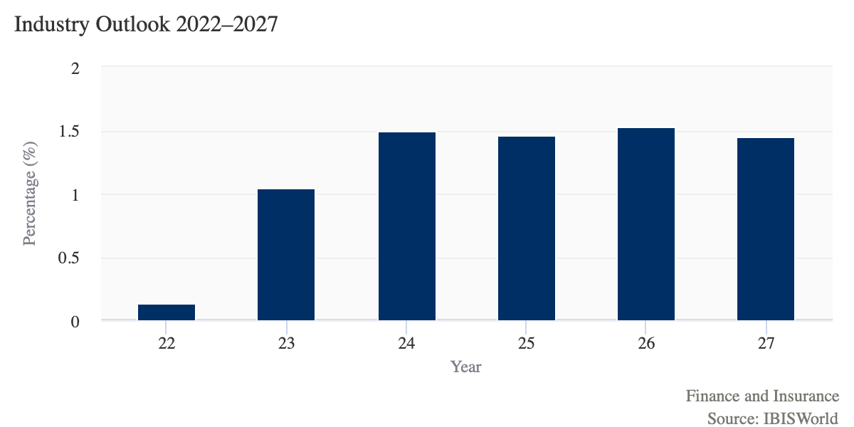
Industry Outlook
Revenue for the Finance and Insurance sector is expected to grow over the five years to 2027 as the economy continues to growth in the aftermath of the COVID-19 (coronavirus) pandemic.
In particular, revenue growth in the outlook period is expected to be attributable to the gradual process of interest rate increases. Furthermore, corporate profit and disposable income levels are expected to rise over the next five years, leaving consumers and businesses better situated to manage rising financing costs. Additionally, after insurance industries experienced premiums' prices rise over the five years to 2022, insurance companies are expected to continue to raise premium prices over the coming years, according to polling done by Fitch Ratings and Willis Towers Watson. Overall, sector revenue is expected to increase an annualized 1.4% to $6.1 trillion over the five years to 2027.
‹#›

Slide 5
Investment Merits
Strong resilience of financial industry allows the system to play the shock absorption and policy transmission roles.
The new financial services industry emerging, attracting capital from many sources and garnering more involvement from big tech.
a. Risk intermediation services.
b. Value technology services.
c. Connected data services.
Life cycle stage: Mature SVA is expected to increase an annualized 1.2% over the 10 years to 2027. This is compared with US GDP, which is expected to grow an annualized 1.8% in the same period. New fintech companies have joined the sector in the hopes of providing scalable solutions to finance and insurance companies' complex issues.
‹#›

Slide 6
SWOT Analysis
Strengths & Opportunities
Weaknesses & Threats
Low Customer Class Concentration
Low Capital Requirements
High Revenue Growth (2017-2022)
High Revenue Growth (2022-2027)
High Performance Drivers
Consumer confidence index
Low Profit vs. Sector Average
High Product/Service Concentration
Low Revenue per Employee
Per capita disposable income
‹#›

Slide 7
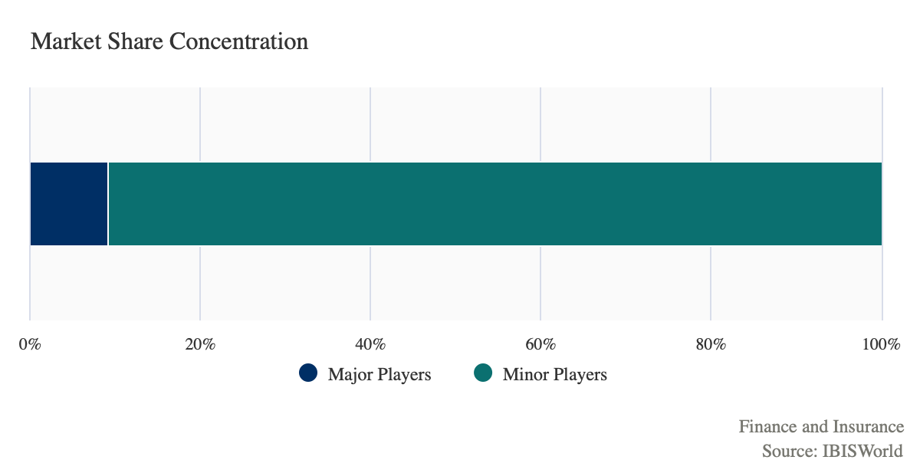
Competitive Landscape
Market Concentration: Low
The sector offers a wide array of products and services to downstream consumers, making it next difficult for any single operator to control a large portion of the total sector.
Over the five years to 2022, market share concentration in the industry has slightly increased. This has been a result of some consolidation that the sector's largest operators have been a part of, and large operators growing pricing power and brand reputation during the period.
‹#›

Slide 8
Segments of Interest
Segment of Interest
Rationale
Investment Banking & Securities Dealing
As future expectations of economy goes down, companies possess higher demands for capital raising. Investment banks that focuses on certain benefited sectors may generate revenue beyond forecast.
Private Equity, Hedge Funds & Investment Vehicles
Fintech
Insurance
‹#›

Slide 9
Public Comparables
‹#›

Slide 10
About Brandeis Investment Club
Founded in 1998, the Brandeis Investment Club was established to provide the highest quality undergraduate investing experience for students interested in pursuing careers in finance. We provide our members with the opportunity to learn finance “hands on” through the collaborative management of a real portfolio. Through our coveted New Analyst Training Program, we provide our newest members with the ability to invest using the basic technical valuation methods of fundamental analysis. Over the course of several years, our analysts have the opportunity to invest in real time using a process developed in conjunction with industry experts with a portion allocated to us by the university’s endowment. We also provide career-oriented training which enables our members to be placed in highly competitive entry-level jobs in finance. In collaboration with industry professionals, Brandeis faculty, and our club members, we are continuing to build an incredible organization, fully devoted to its members’ success.
Mike Yan
haipengyan@brandeis.edu
Head Analyst
Yu Chen
yuc@brandeis.edu
Analyst
Christina Lin
christinalin@brandeis.edu
Analyst
Zachery Hovatter
zhovatter@brandeis.edu
Analyst
Thao Dang
thaodang@brandeis.edu
Analyst

